Slide 1
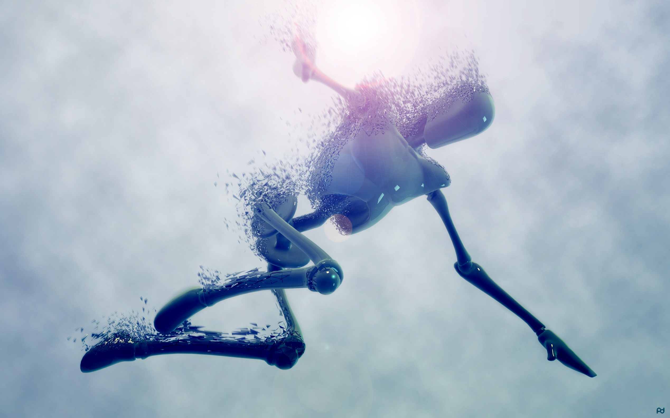
Robots in the oceans

Slide 2
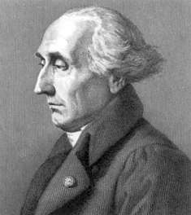

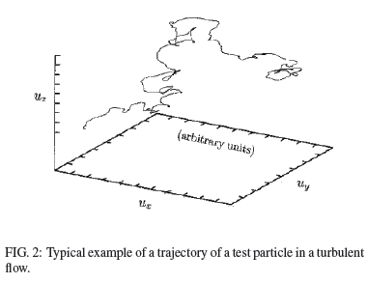
What does the term LAGRANGIAN mean?
Lagrangian mechanics was introduced by the Italian-French mathematician and astronomer Joseph-Louis Lagrange in 1788. In Lagrangian mechanics, the trajectory of a system of particles is derived by solving the Lagrange equations. In each case, a mathematical function called the Lagrangian is a function of
the generalized coordinates,
their time derivatives,
and time

Slide 3
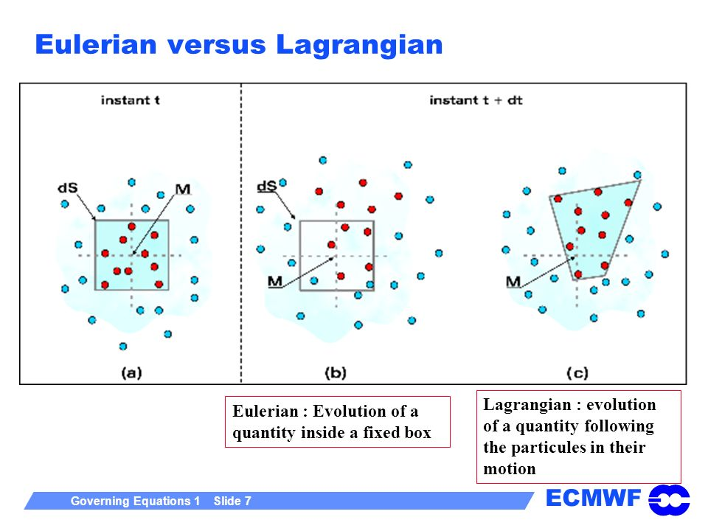

Slide 4
1. ARGO FLOATS

Slide 5
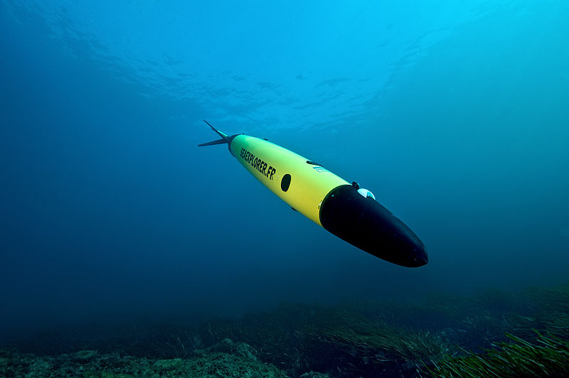
Introduction
Autonomous Underwater Vehicles (AUVs) are programmable, robotic vehicles that, depending on their design, can drift, drive, or glide through the ocean without real-time control by human operators.
Some AUVs communicate with operators periodically or continuously through satellite signals or underwater acoustic beacons to permit some level of control.
Some AUVs can also make decisions on their own, changing their mission profile based on environmental data they receive through sensors while under way.
Advantages:
Tether less
Carries own power
No pilot
Pre-programmed
Easy Launch and Recovery
SeaExplorer Glider
3.

Slide 6
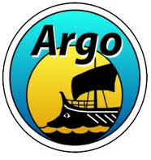
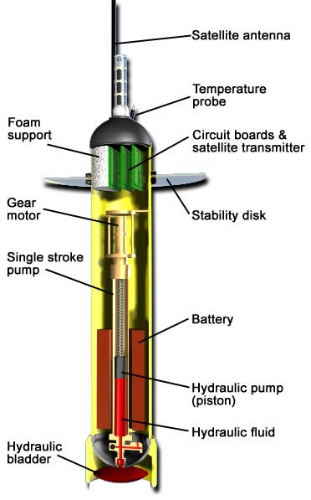
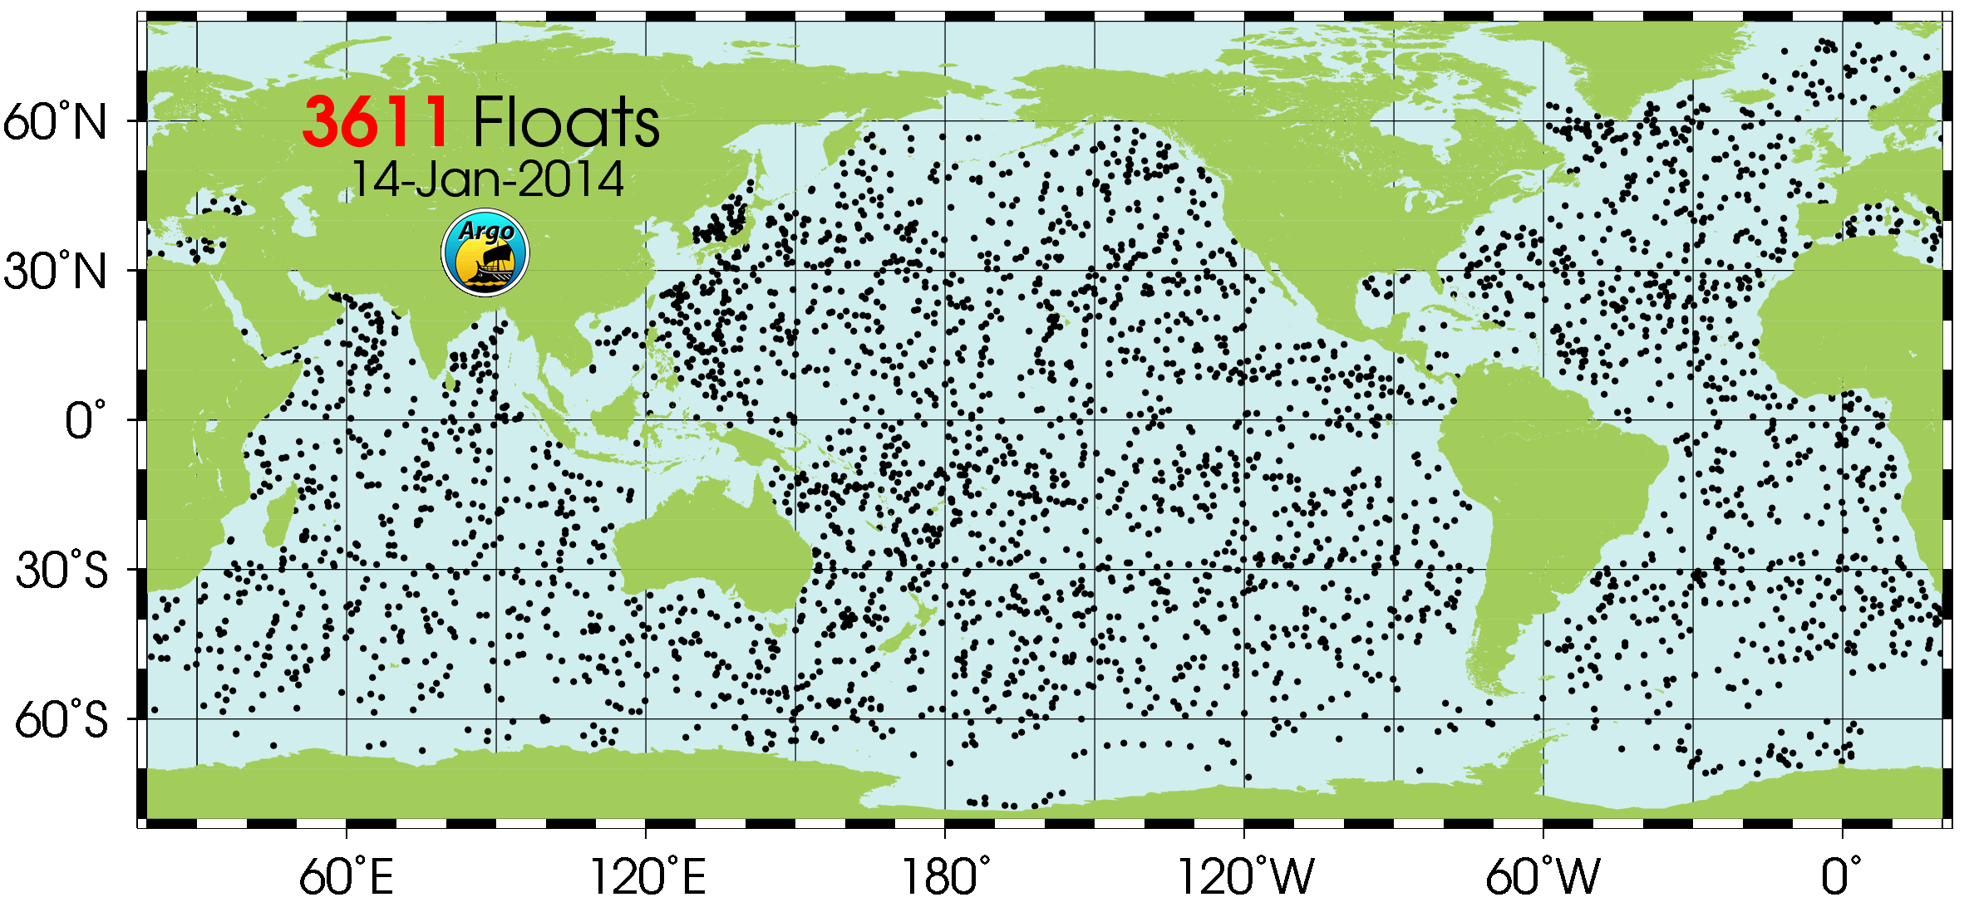
A/ Argo Floats
1. What is Argo ?
Argo is a global array of more than 3,000 free-drifting profiling floats that measures the temperature and salinity of the upper 2000 m of the ocean. This allows, for the first time, continuous monitoring of the temperature, salinity, and velocity of the upper ocean, with all data being relayed and made publicly available within hours after collection.
Argo types:
APEX – Webb: Commercially manufactured. Largest part of Argo array.
PROVOR – Metocean: Commercially manufactured.
SOLO – SIO and WHOI: built at institutes.
4.

Slide 7
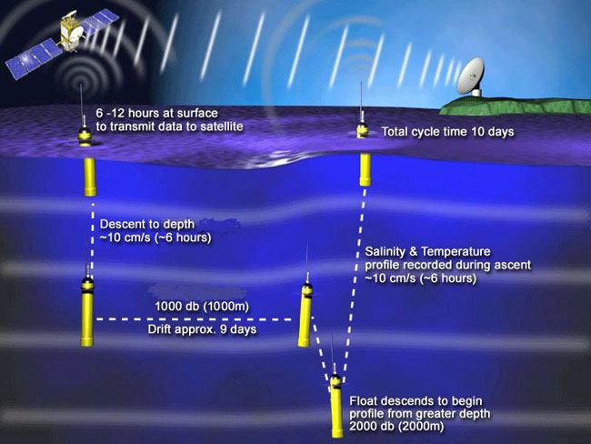
A/ Argo Floats
2. How does it work ?
TRANSMISSION SYSTEMS
Service Argos (CLS)
Highly compressed raw data
Spend 12-14 hours on the surface to transmit data
Repetitive transmissions of all data
Argos positioning
Orbcomm and Iridium (“satellite phone”)
Not much compression of raw data needed
Spend typically 1h or less on the surface
One transmission of all data
GPS positioning
5.

Slide 8
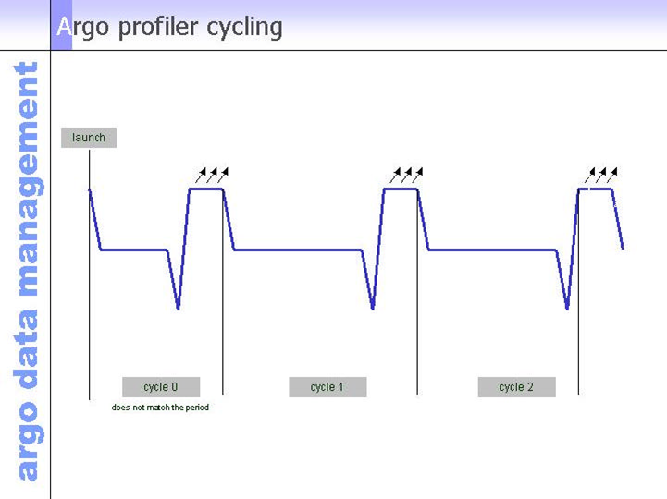
A/ Argo Floats
2. How does it work ?
6 hours of
transmissions
at startup
Data is collected at the end of cycle 1
Cycle
time
Down
time
Up
time
6.

Slide 9

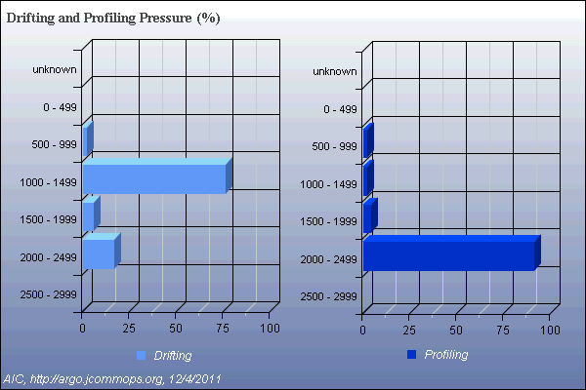
A/ Argo Floats
2. How does it work ?
Pressure (dbar)
Number of Argo floats in %
7.

Slide 10
A/ Argo Floats
2. How does it work ?
A core aim of ARGO was to keep data records consistent hence the 2000m is the predominant profiling depth.
8.

Slide 11
A/ Argo Floats
3. Pros & Couns !
ADVANTAGES
Float are easy to deploy, they can conduct long-lived missions and they acquire and communicate data to researchers throughout the world without the direct involvement of ships or people.
New designs include oxygen, bio-optic sensors.
They are truly Robots in the Ocean !
Improve ocean models, ocean forecasting.
Incorporated into WOD13 and Levitus
Cheap compared to cruises ! And freely available.
LIMITATIONS
Data sets recorded by floats can contain small gaps.
No control of where they go.
They are truly Robots in the Ocean !
Data only collected on the ascending cast.
Not always easy to get the data.
9.

Slide 12
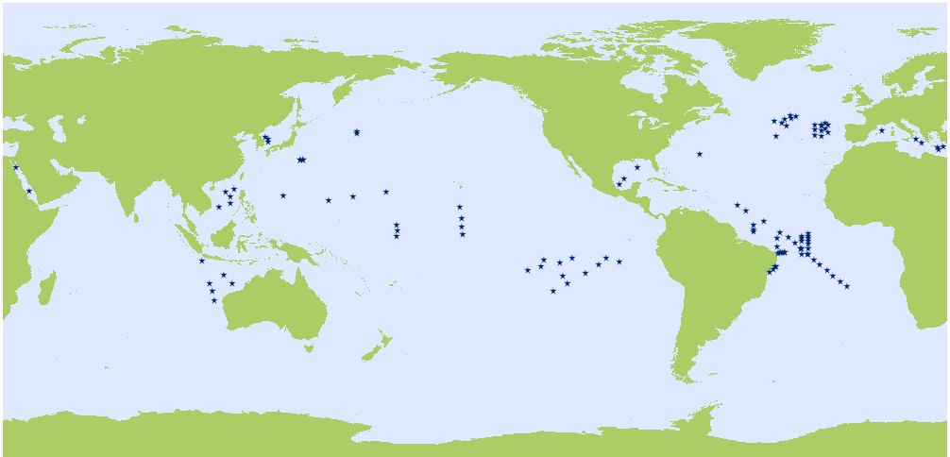
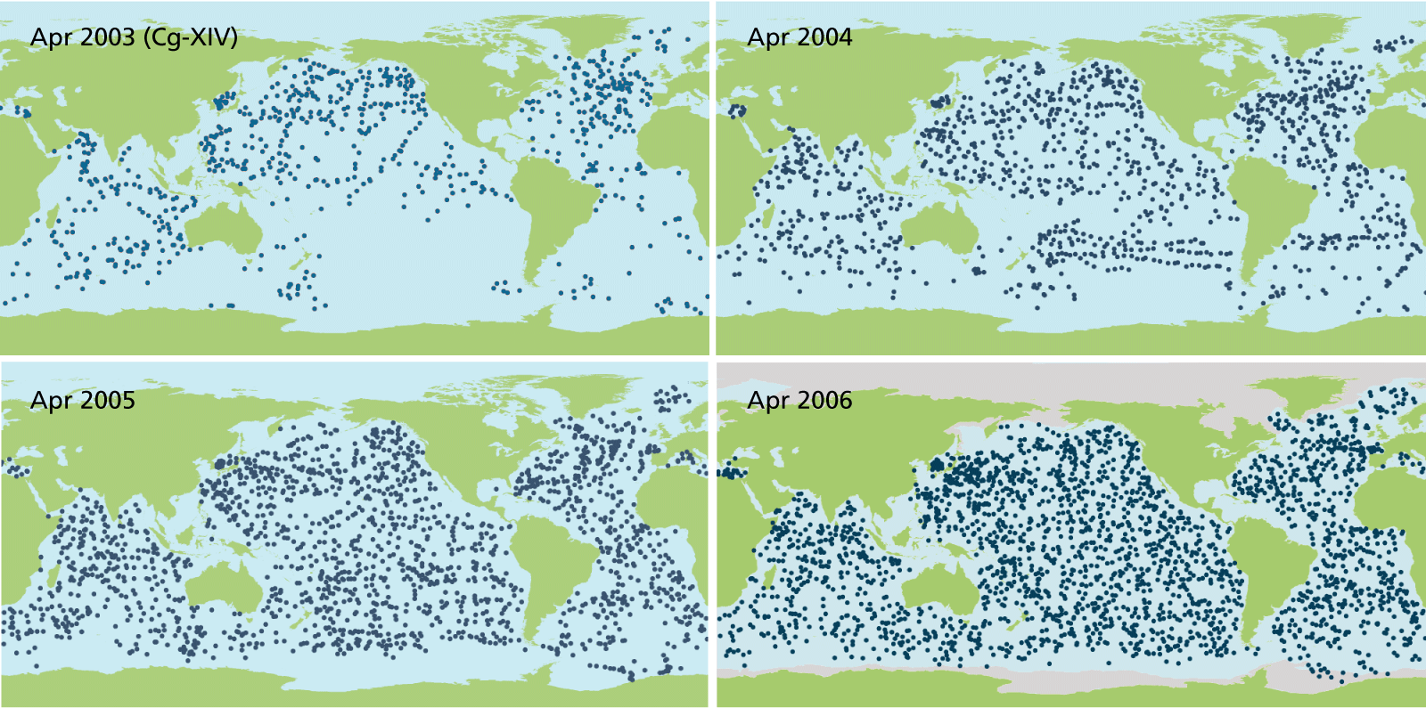
B/ The Argo Network
2000
The Argo network has achieved its initial target. Improving, sustaining and maintaining it remains a challenge.
10.

Slide 13
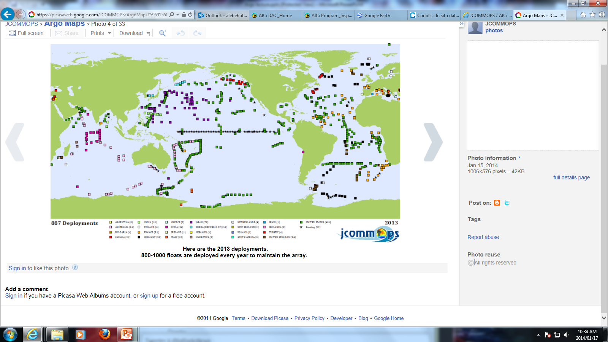
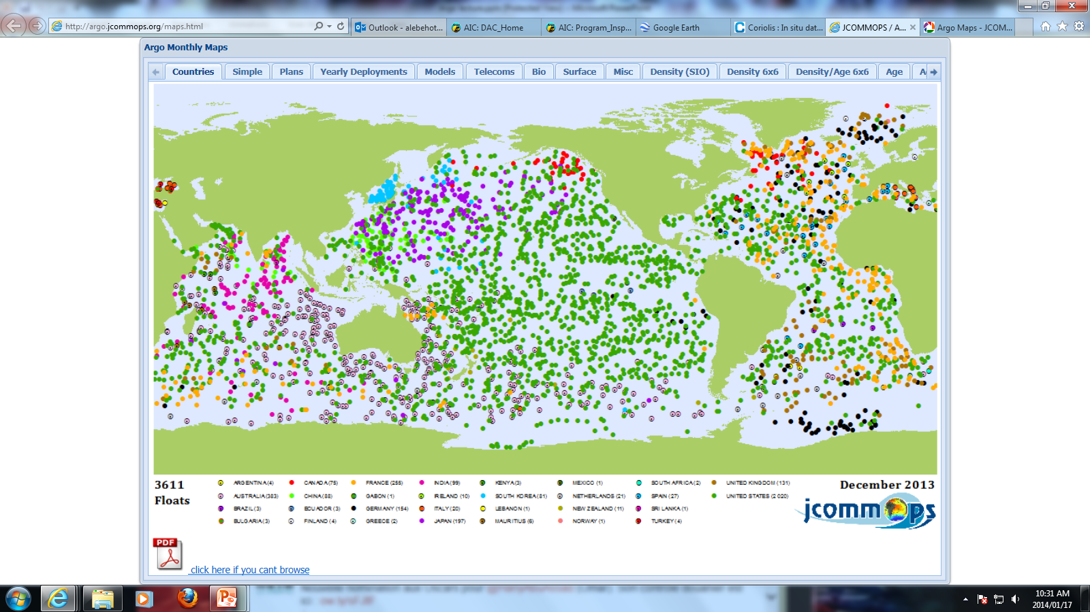
B/ The Argo Network
In December 2013, on the 3611 floats:
- 2020 United States (Green)
- 383 Australia (Pink)
- 81 France (Yellow)
- (South Africa 2)
(Latest maps on:
http://argo.jcommops.org/maps.html )
Due to ice cover, there are still some areas that are not well-covered by Argo floats (the Southern Ocean and the Arctic Region). Indeed, they cannot reach the surface and transfer their information. Argo is not suitable under these conditions.
11.

Slide 14
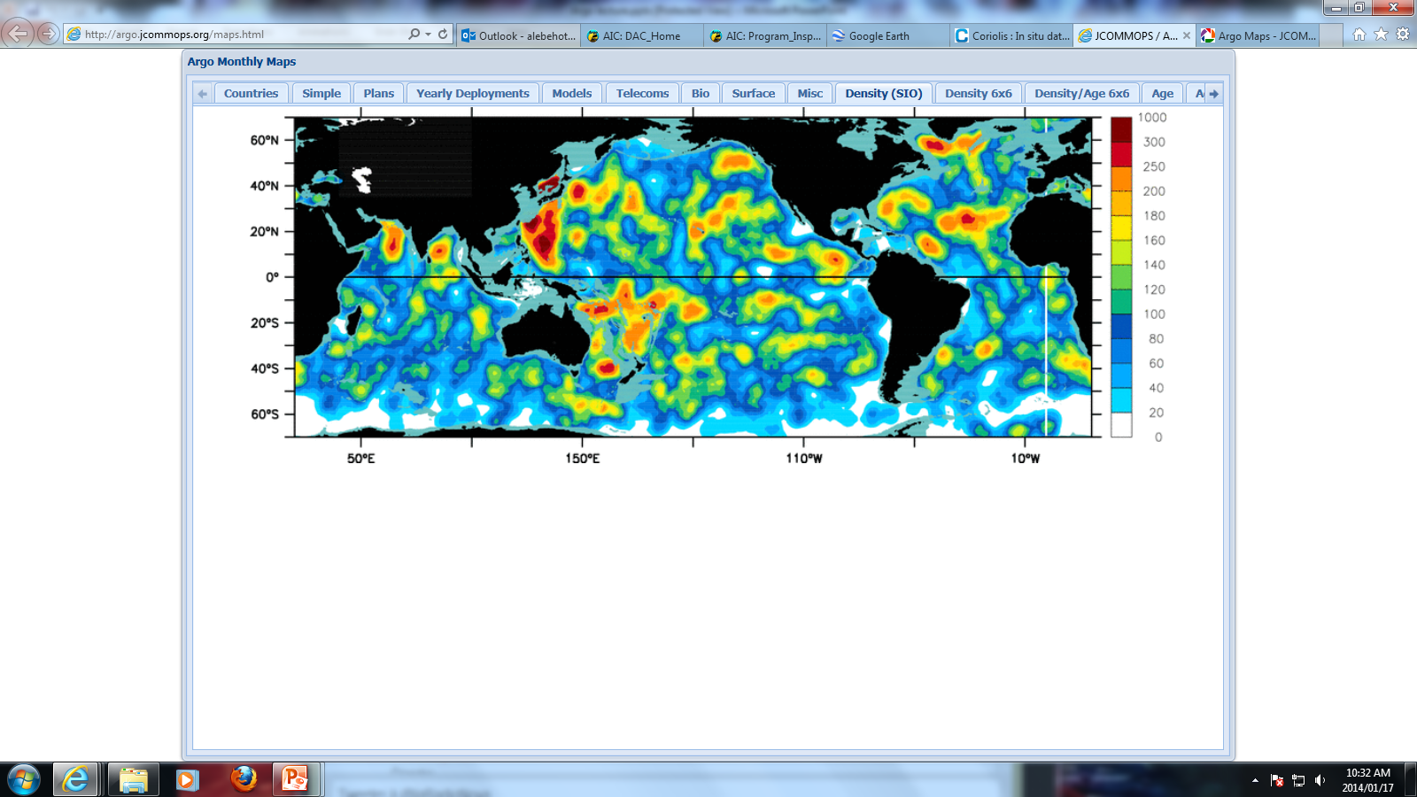
B/ The Argo Network
887 deployments in 2013:
401 United States (Green)
81 France (Yellow)
78 Japan (Purple)
(South Africa 0)
Float coverage today as a density plot:
800-1000 floats are deployed every year to maintain the array.
12.

Slide 15
2. GLIDERS

Slide 16
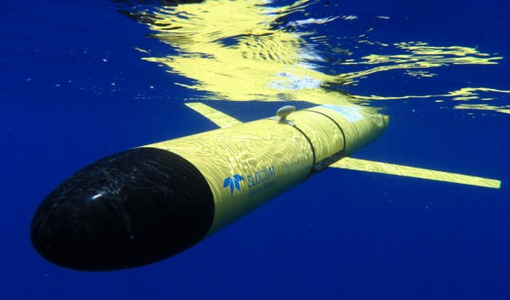
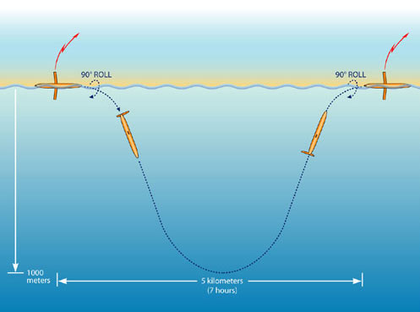
A/ Gliders
Gliders monitor properties such as water currents, temperature, conductivity, bottom depth or chlorophyll fluorescence.
The robots collect information from deep water, as well as at the surface.
Gliders are a low cost effective technique due to their very low power consumption. Indeed to propel itself forward they use small changes in its buoyancy in conjunction with wings to convert vertical motion to horizontal.
Collecting data as it rises.
Gliders follow an up-and-down, sinusoidal-like profile through the water, providing data on temporal and spatial scales.
They navigate with the help of periodic surface GPS fixes, pressure sensors, tilt sensors, and magnetic compasses.
A Spray Glider in action
3.

Slide 17
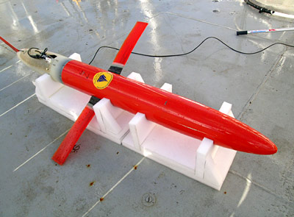
A/ Gliders
There are different types of gliders, that uses different techniques to propel itself forward, depending on its purpose and design. Here 2 examples of Gliders:
1. Spray Glider
Spray Gliders are used to take vertical profiles of data (can operate to 1500m deep), giving a clearer understanding of the temperature, salinity, and turbidity of specific areas of the oceans.
No external moving parts or motors. Instead, they move by pumping mineral oil between two bladders, one internal and the other external to the hull. This action changes the volume of the glider, making it denser or lighter than the surrounding water.
Length = 2m
Wingspan=1.2 meters
As it rises, the Spray Glider collects data. At the surface, researchers obtain data via satellite and an antenna embedded in the left wingtip, then they send new instructions.
4.

Slide 18
A/ Gliders
1. Spray Glider
ADVANTAGES
Provide a look at entire sections of ocean basins.
Serve as virtual moorings by keeping station at a single point.
Can carry out missions as long as six months in duration.
Work out to 20km per day for a total mission distance of 3,600 km.
LIMITATIONS
Move at modest speeds so best used for monitoring changes over weeks to months.
Not well-suited for small-scale surveys near strong fronts or coastal jets.
Limited to an operating depth of less than 1,500m so they can not make full water depth measurements.
4.

Slide 19
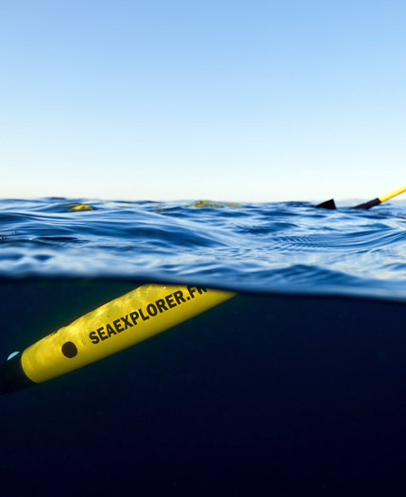
A/ Gliders
2. SeaExplorer Glider
The SeaExplorer vehicle moves through the water by varying its buoyancy, resulting in very long endurance and stealthy actuation. It resurfaces regularly to transmit information back to the operator including its positioning, on the ongoing mission, etc…
The SeaExplorer does not have wings nor external moving parts which facilitates easy launch and recovery operations and reduces the risk of entanglement (plastic debris, seaweed, and so on…).
Due to its high ballast volume, SeaExplorer speed is 1 knot, twice as fast as competitors.
The design has been green technology oriented. Power is only by rechargeable batteries.
SeaExplorer Transmitting
4.

Slide 20
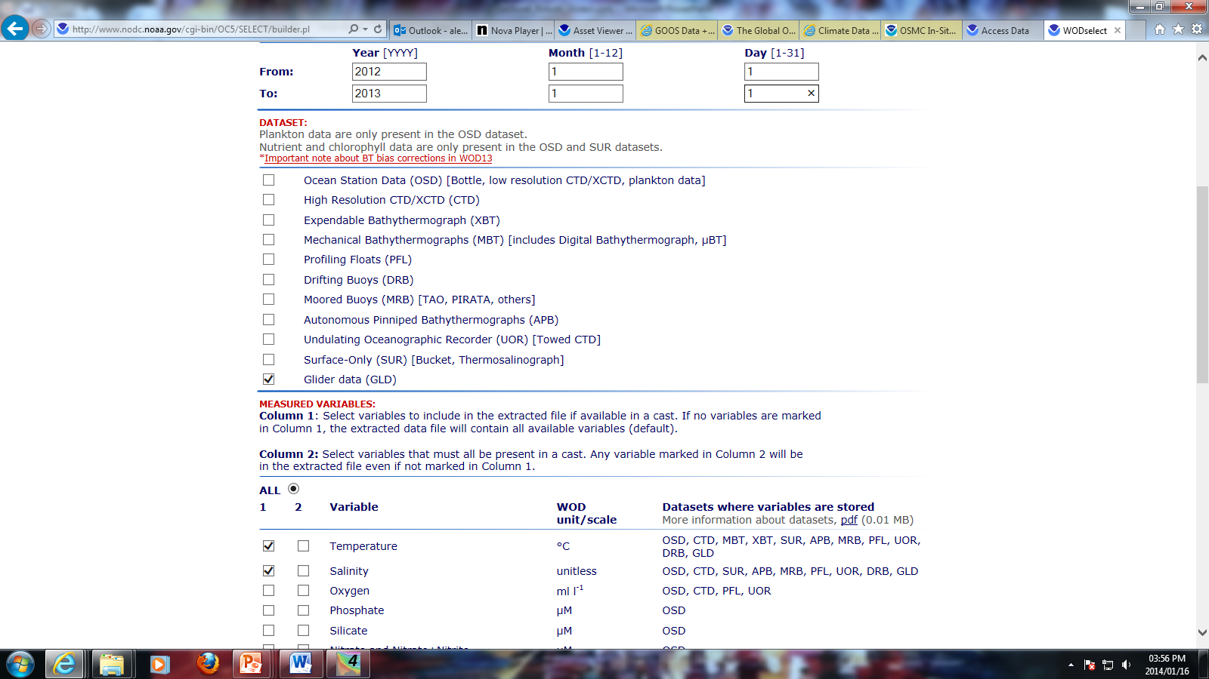
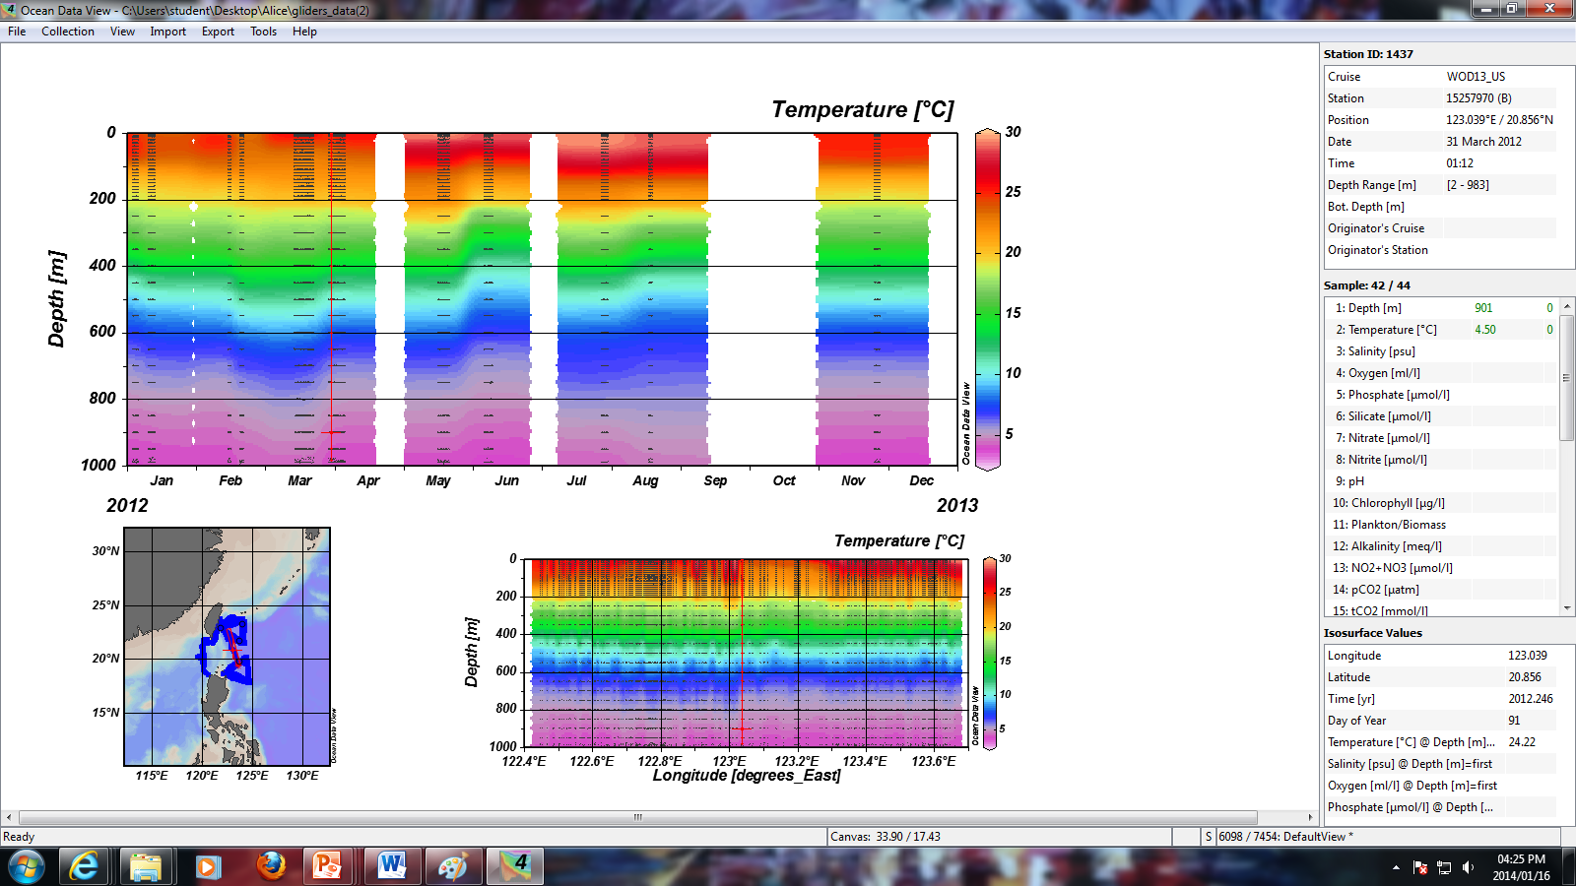
B/ Get Gliders Data
As seen in Lecture Water Column Instruments, the WOD13 easily offers all type of data (included gliders data).
http://www.nodc.noaa.gov/OC5/SELECT/dbsearch/dbsearch.html
1. WOD13
Example: Temperature and salinity study for any gliders for the year 2012.
Importing the data with ODV. (However, no salinity data when we read the file).
4.

Slide 21
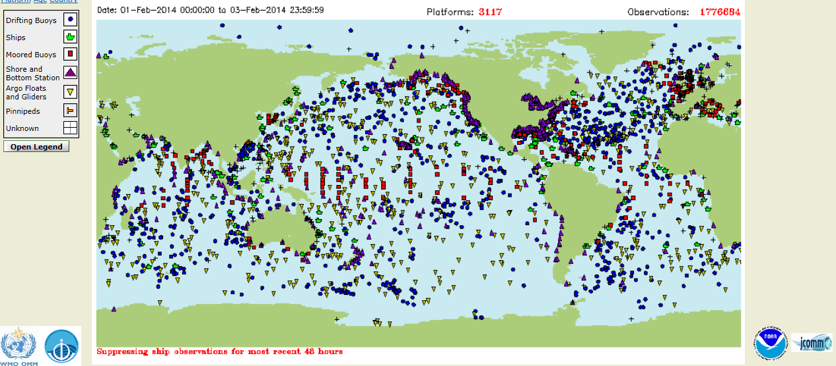
Summary
All the instruments (from buoys to robots)
between the 1st and 3rd of February 2014.
1776684 Observations!!
http://osmc.noaa.gov/Monitor/OSMC/OSMC.html
4.

Slide 22
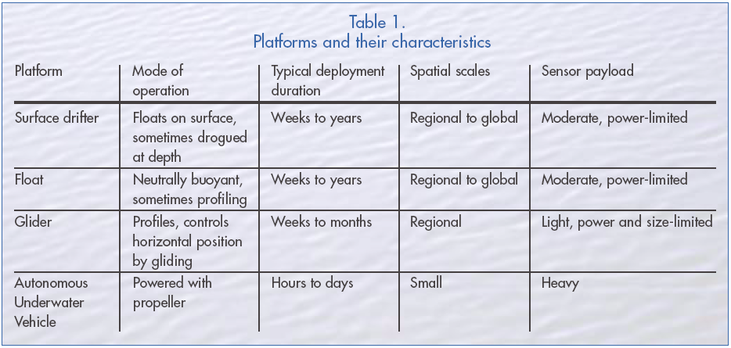
https://samspostgrads.wordpress.com/2012/07/06/hi-tech-rubber-ducks-drifters-gliders-and-argo/

Slide 23
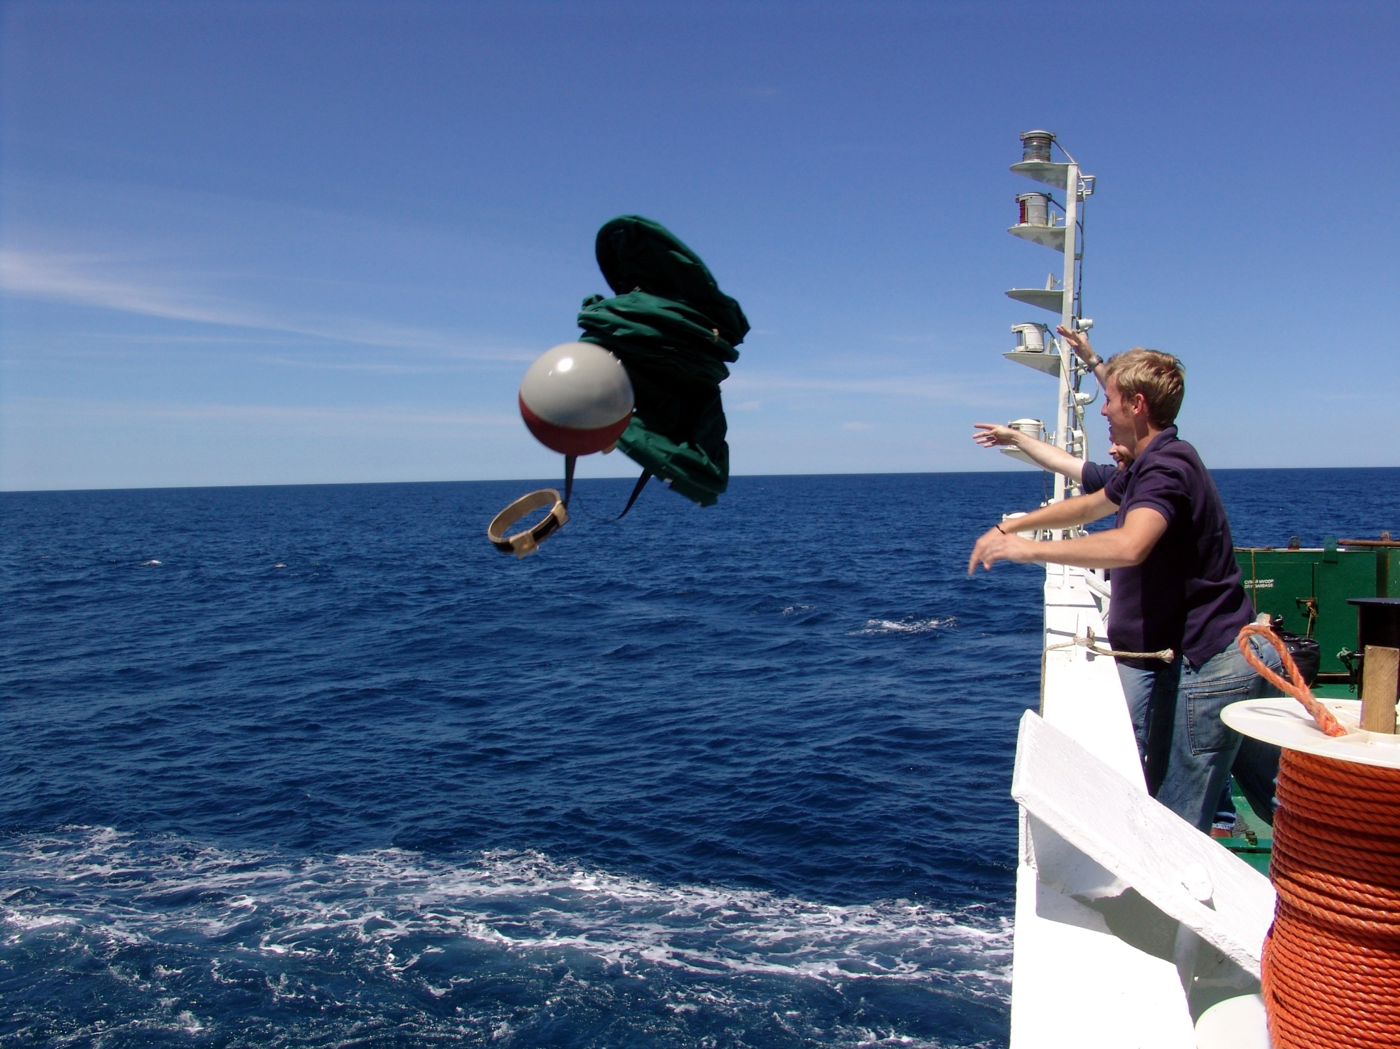

Slide 24
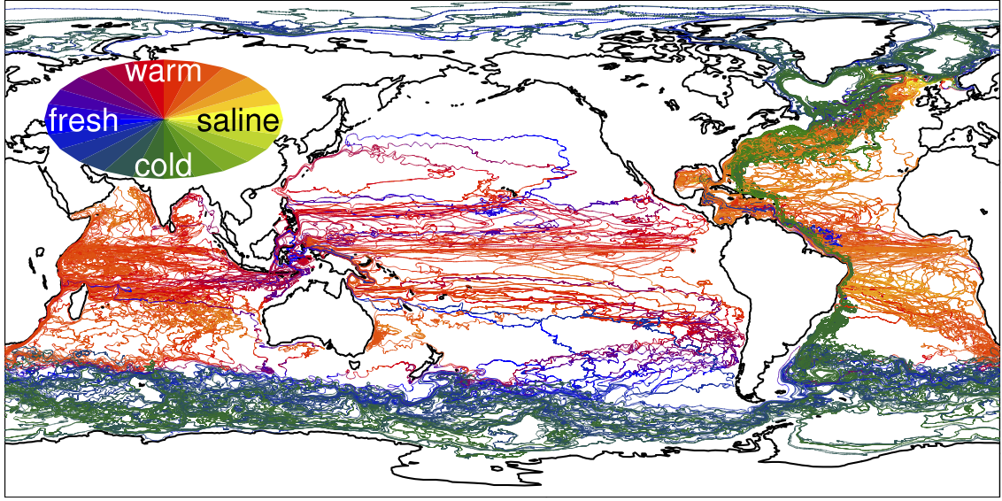
In the ocean what does it look like?

Slide 25
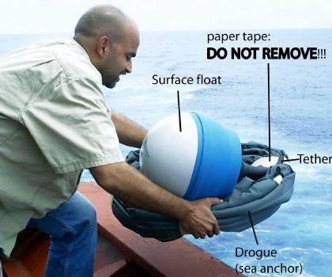
So how can we measure? - Surface Drifters

Slide 26
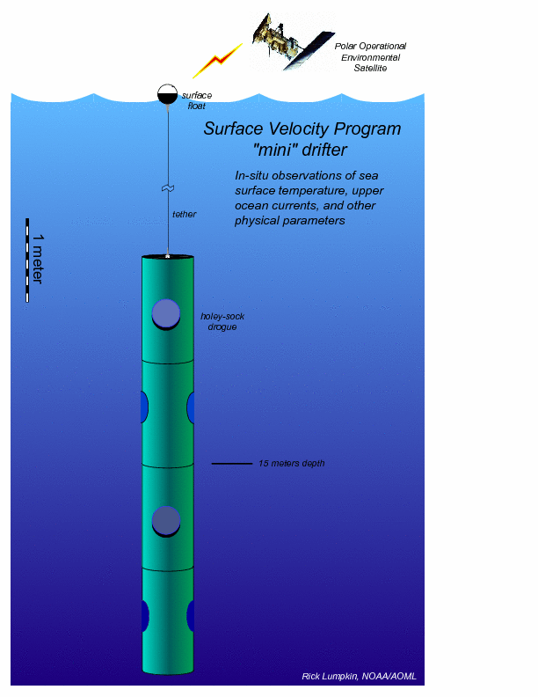
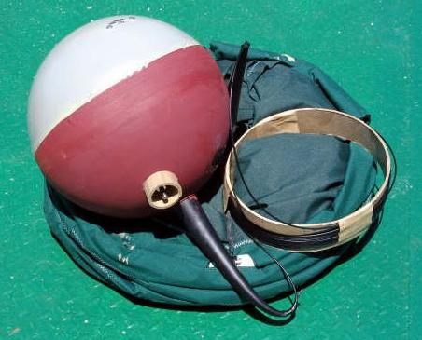
So how can we measure? - Surface Drifters
Measure
Velocity
SST
SSS
Air Pressure
Pressure ± 1hPa; SST ± 0.2K

Slide 27
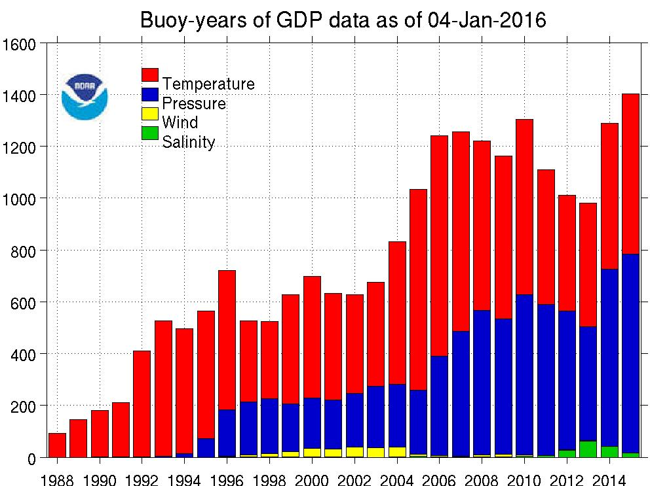

Slide 28
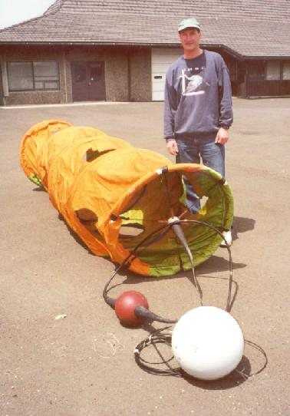
Drifters- tracking methods
Human recovery and reporting
Visual (from land or ship)
Radar ranging (from land or ship)
Radio ranging and directing finding (RDF)
ARGOS transmitter
Via satellite
Via local user terminal (cheaper, but less accurate)
GPS or LORAN position transmitted via packet radio or via cell phone or Iridium satellite
Notes:
Argos is a satellite-based location and data collection system dedicated to monitoring and protecting the environment. Argos lets you locate any platform equipped with a suitable transmitter, anywhere in the world, to within 150 to 1000 meters (using Doppler effect). You can also collect data from sensors connected to the transmitter. Over 10 thousand Argos transmitters are now operating around the world.
The Argos system has been operational since 1978. It was established under an agreement (Memorandum of Understanding) between the National Oceanic and Atmospheric Administration (NOAA, USA), the National Aeronautics and Space Administration (NASA, USA) and the French Space Agency (CNES).
Argos is operated and managed by Collecte, Localisation, Satellites (CLS), a CNES subsidiary in Toulouse, France and Service Argos, Inc., a CLS North American subsidiary, in Largo, Maryland, near Washington, DC, USA.
Argos is easy to use. Your transmitter starts sending signals as soon as you switch it on. The satellites collect the data and retransmit it to the Argos centers for processing. Accessing your data is just as easy. You can retrieve your results from anywhere in the world by public data networks, often within 20 minutes of transmission.
Another attractive feature of the Argos system is the small transmitters: -average daily power consumption is as low as a few milliamps, -miniaturized models can be as compact as a small matchbox, weighing as little as 15 g.
These features mean that Argos can be used to track small animals, such as birds.
The Argos receivers are carried on-board NOAA series satellites. At least two satellites are simultaneously in service (currently 6 NOAA satellites are in service with Argos instruments) on polar, sun-synchronous, circular orbits at 850 km altitude, providing full global coverage. You also have the possibility to receive your data in real-time due to our network of Local User Terminals/Receivers.

Slide 29
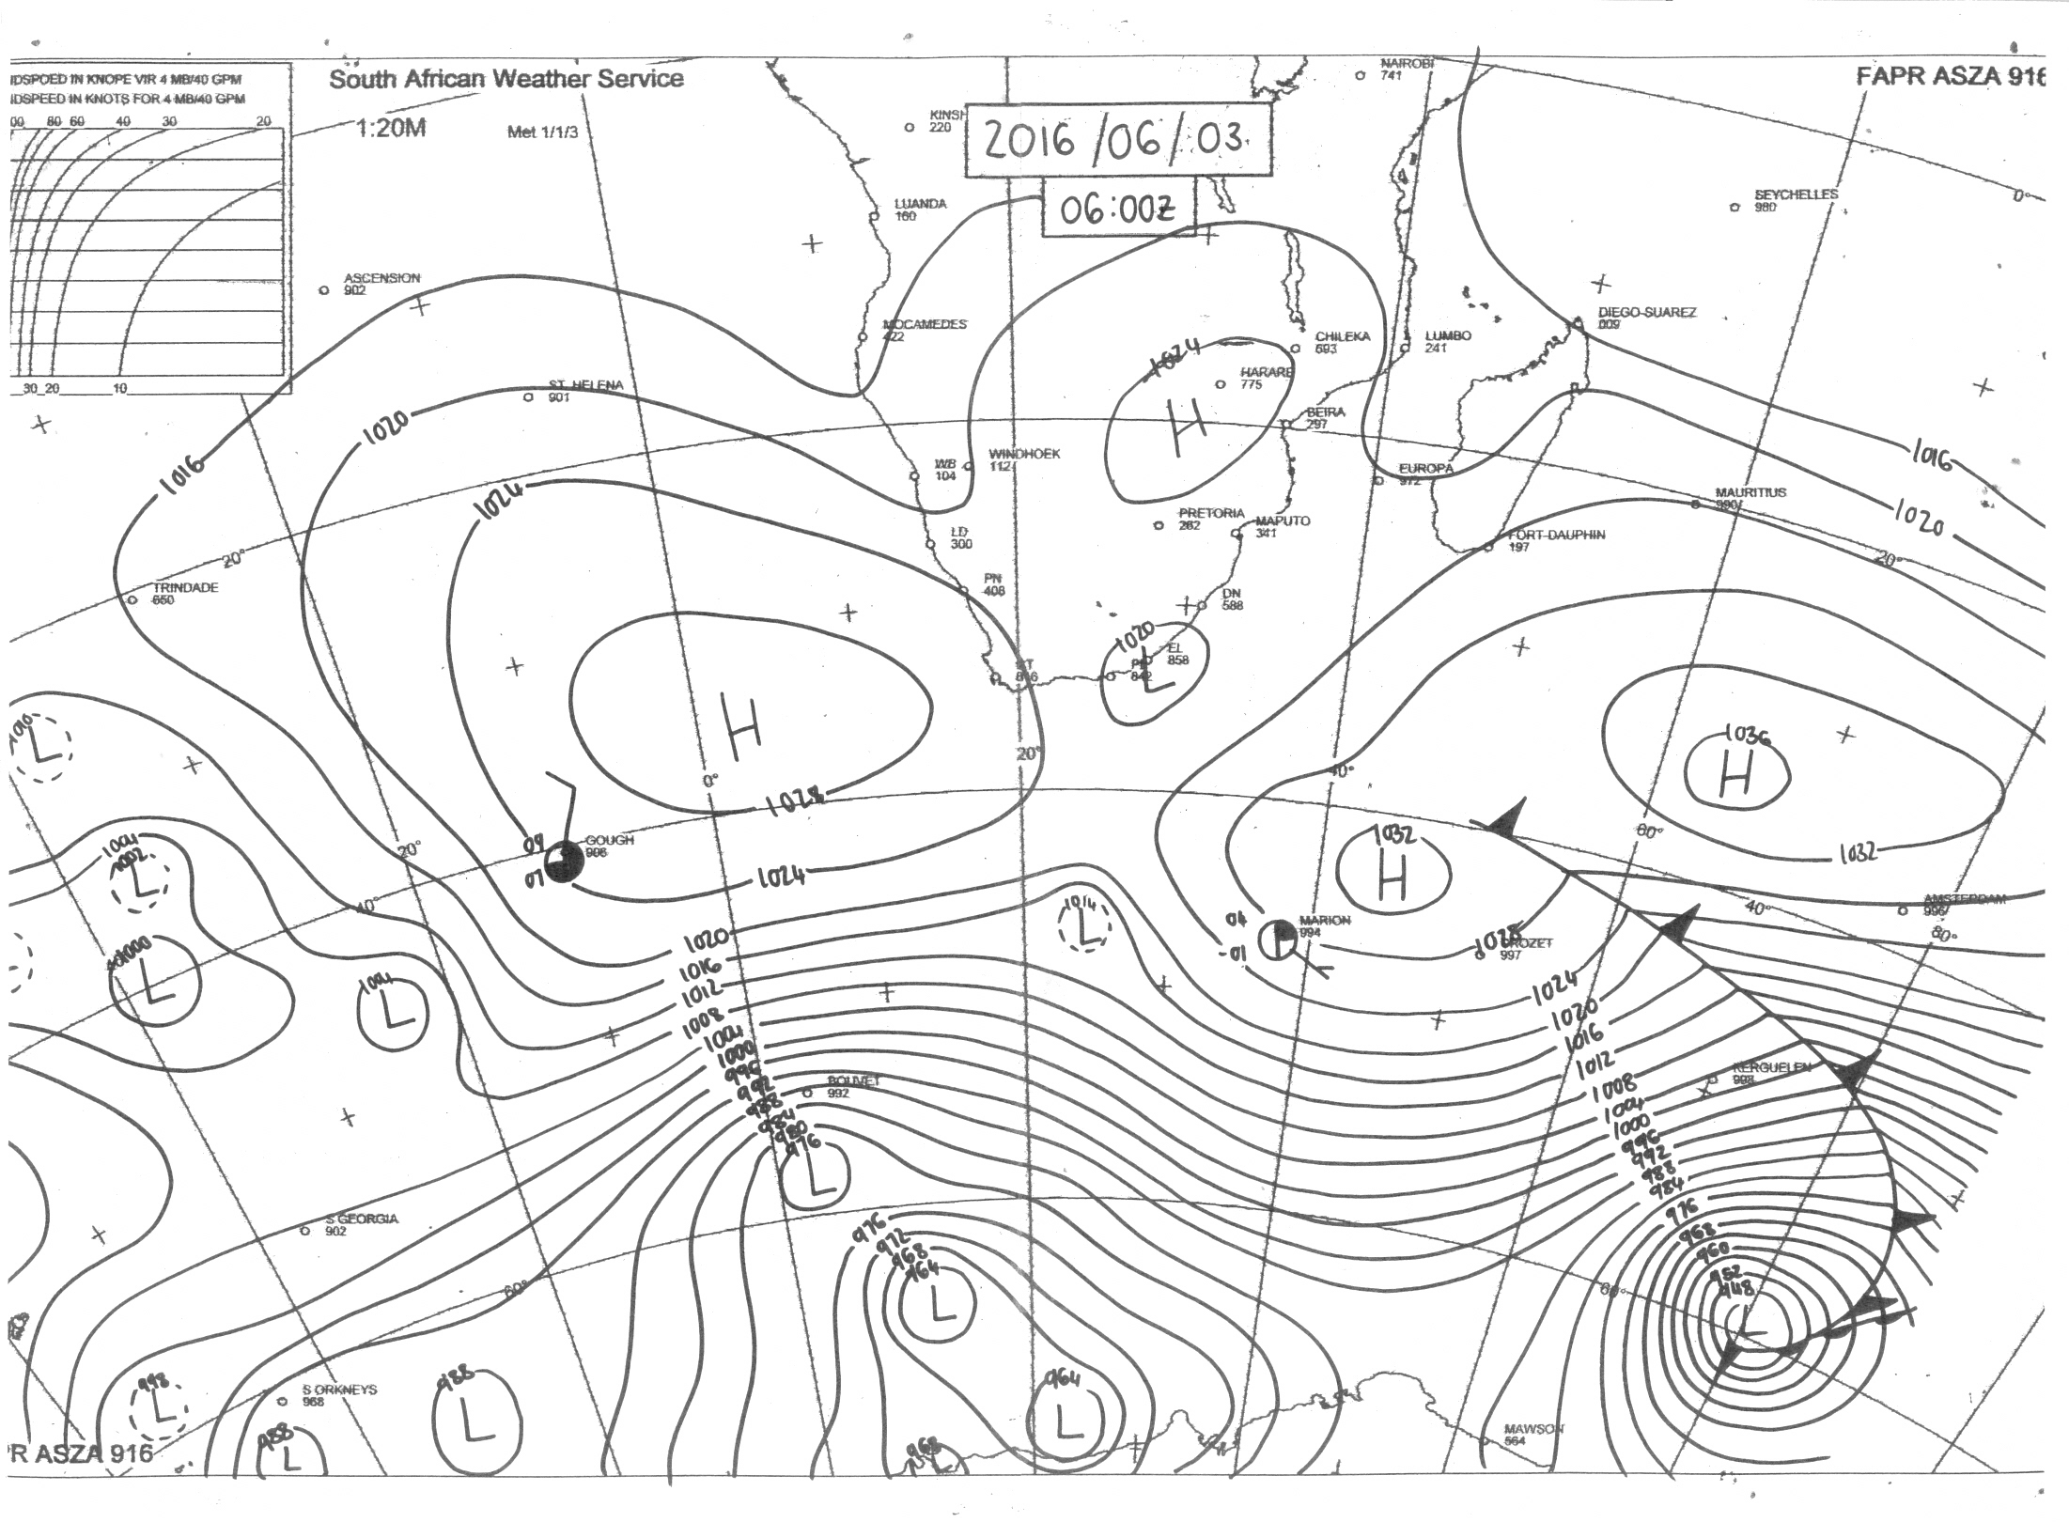
WHY measure??

Slide 30
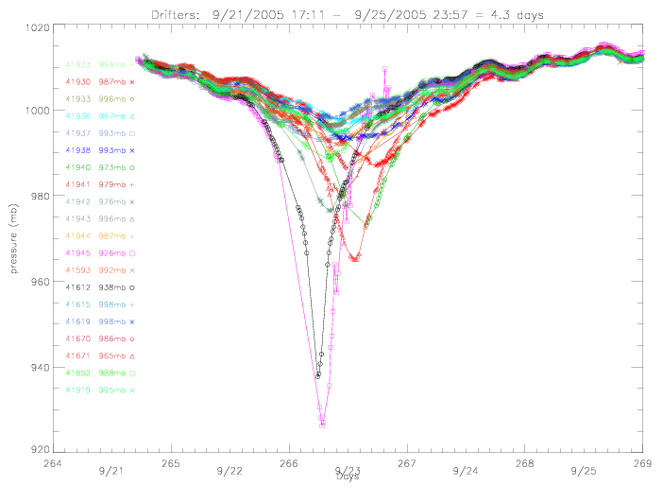
Drifters used to monitor hurricanes….

Slide 31
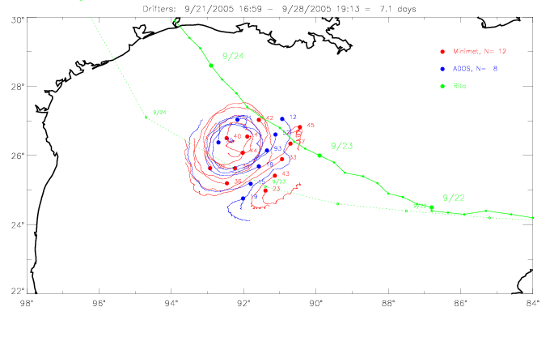
Drifters used to monitor hurricanes….

Slide 32
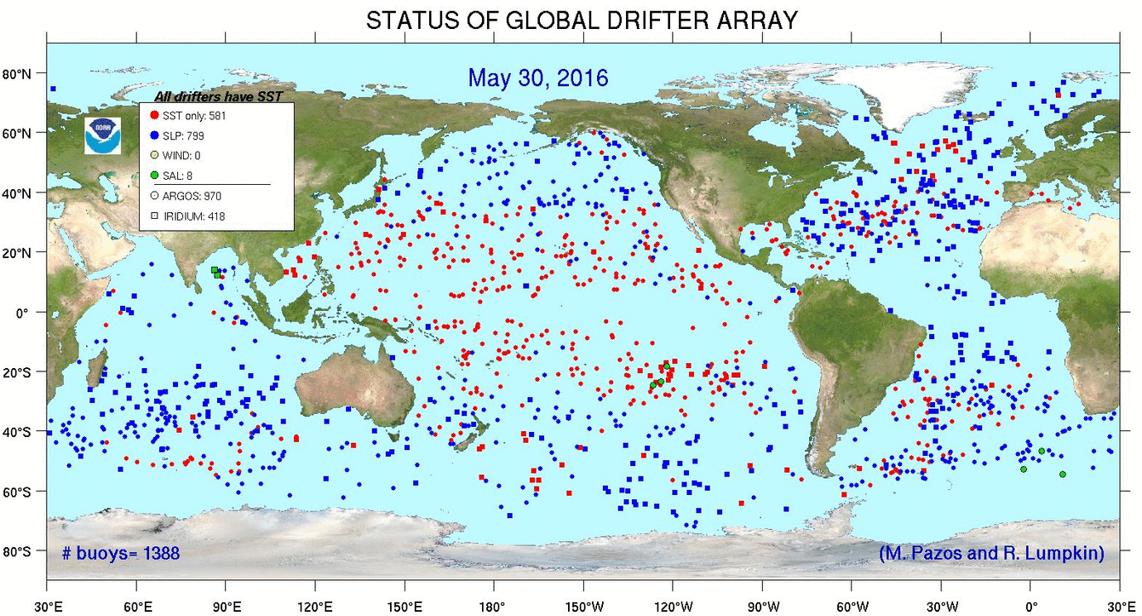
http://www.aoml.noaa.gov/phod/dac/index.php

Slide 33
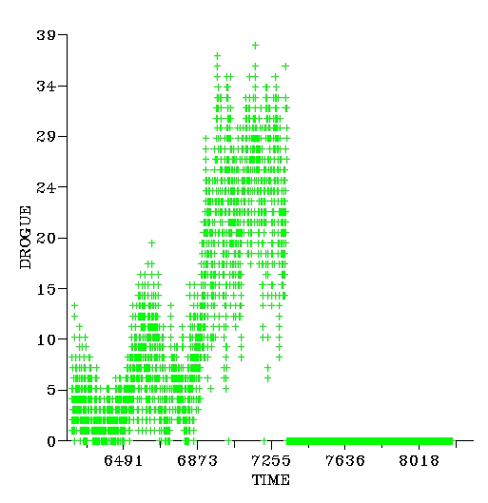
Drogue presence detection
Drogue adds large inertial mass
Small residual buoyancy
Buoy submerged for much of the time in rough seas
Depth of submersion may be >> 1m
Submersion sensor used to detect presence/absence of drogue
Submersion %
Drogue loss
Courtesy M Pazos, AOML

Slide 34
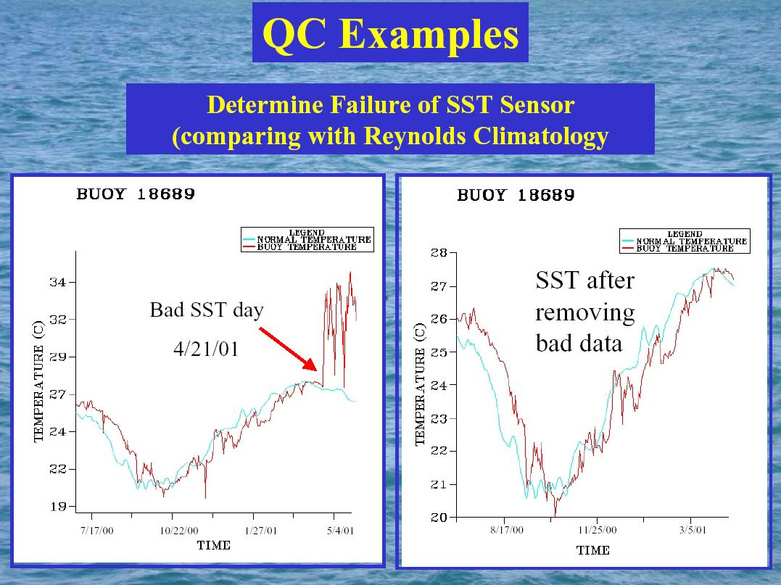
Drogue presence detection
Drogue adds large inertial mass
Small residual buoyancy
Buoy submerged for much of the time in rough seas
Depth of submersion may be >> 1m
Submersion sensor used to detect presence/absence of drogue
Courtesy M Pazos, AOML

Slide 35
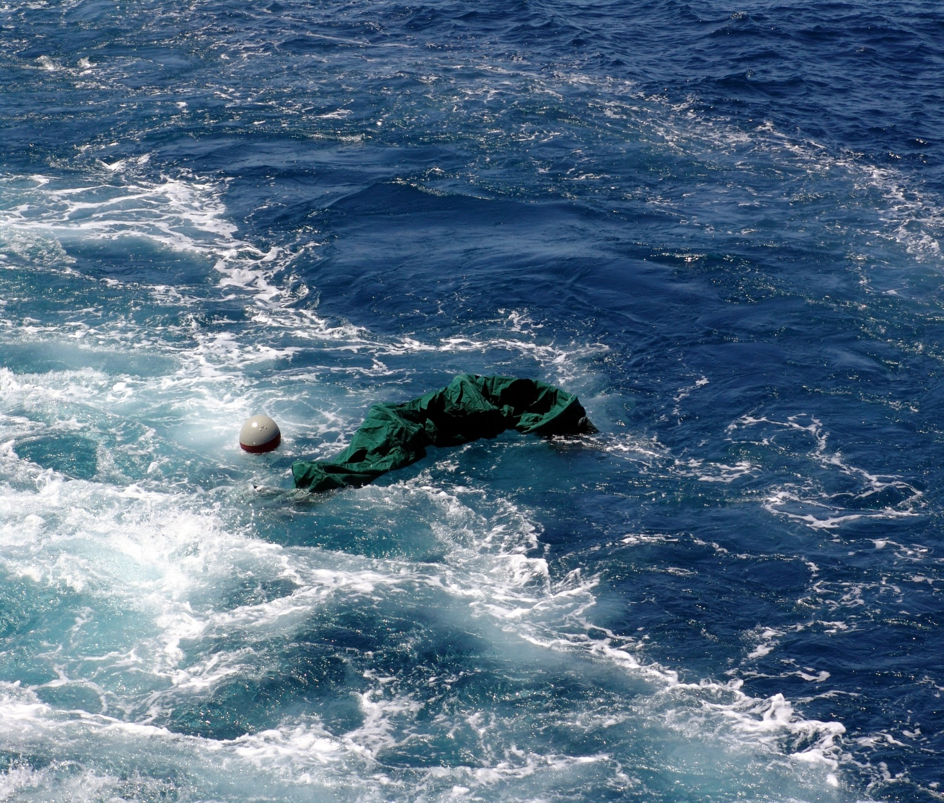
Problem is
Surface measurements only!
Non retrievable
But very easy to deploy!

